Slide 1
Filtering, Joins and Aggregation
Joins
In SQL, joins are commands that are used to combine rows from two or more tables.
These tables are combined based on a related column between those tables.
Inner, left, right, and full are four basic types of SQL joins.
Venn diagram is the easiest way to explain the difference between these four types.
Employee Table
Department Table
ID | STATE
10 | AB
11 | AC
12 | AD
ID | BRANCH
11 | Computer
12 | Civil
13 | Mech

Slide 2
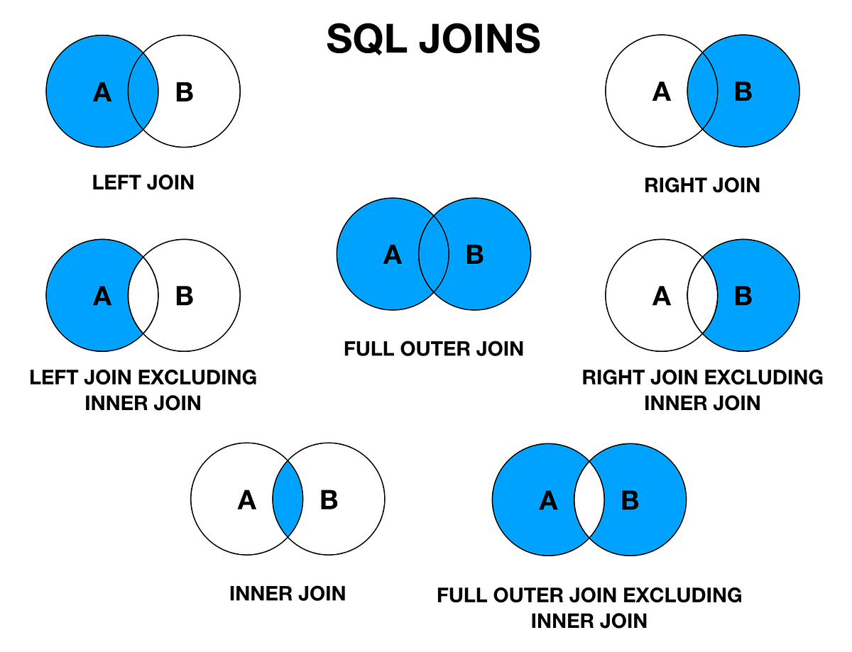

Slide 3
Inner Join
The inner join selects all rows from both tables as long as there is a match between the columns.
This join returns those records that have matching values in both tables.
Emp Table
Dept Table
ID | STATE
10 | AB
11 | AC
12 | AD
ID | BRANCH
11 | Computer
12 | Civil
13 | Mech
SELECT *
FROM Emp inner join Dept
on Emp.ID = Dept.ID;
ID | STATE | ID | BRANCH
11 | AC | 11 | Computer
12 | AD | 12 | Civil

Slide 4
Left Outer Join
The left outer join (or left join) returns all the rows of the left side table and matching rows in the right side table of the join.
The rows for which there is no matching row on the right side, the result will contain NULL.
Emp Table
Dept Table
ID | STATE
10 | AB
11 | AC
12 | AD
ID | BRANCH
11 | Computer
12 | Civil
13 | Mech
SELECT *
FROM Emp left outer join Dept
on Emp.ID = Dept.ID;
ID | STATE | ID | BRANCH
10 | AB | NULL | NULL
11 | AC | 11 | Computer
12 | AD | 12 | Civil

Slide 5
Right Outer Join
The right outer join (or right join) returns all the rows of the right side table and matching rows for the left side table of the join.
The rows for which there is no matching row on the left side, the result will contain NULL.
Emp Table
Dept Table
ID | STATE
10 | AB
11 | AC
12 | AD
ID | BRANCH
11 | Computer
12 | Civil
13 | Mech
SELECT *
FROM Emp right outer join Dept
on Emp.ID = Dept.ID;
ID | STATE | ID | BRANCH
11 | AC | 11 | Computer
12 | AD | 12 | Civil
NULL | NULL | 13 | Mech

Slide 6
Full Outer Join
The full outer join (or full join) returns all those records that have a match in either the left table (Emp) or the right table (Dept) table.
The joined table will contain all records from both the tables, and if there is no matching field on either side, then fill in NULLs.
Emp Table
Dept Table
ID | STATE
10 | AB
11 | AC
12 | AD
ID | BRANCH
11 | Computer
12 | Civil
13 | Mech
SELECT *
FROM Emp full outer join Dept
on Emp.ID = Dept.ID;
ID | STATE | ID | BRANCH
10 | AB | NULL | NULL
11 | AC | 11 | Computer
12 | AD | 12 | Civil
NULL | NULL | 13 | Mech

Slide 7
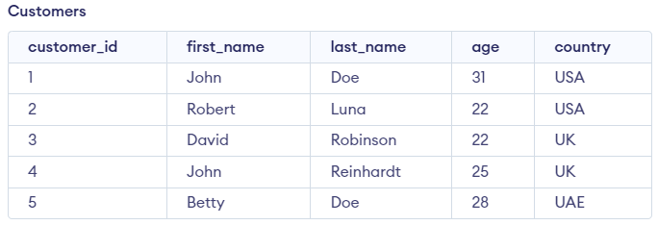

Aggregation
SQL provides the following built-in functions for aggregating data.
COUNT()
AVG()
SUM()
MIN()
MAX()
The COUNT() function returns the number of values in the dataset.
SELECT COUNT(customer_id)
FROM Customers;

Slide 8

Aggregation: AVG()
The AVG() function returns the average of a group of selected numeric column values.
SELECT AVG(age) FROM Customers;

Slide 9

Aggregation: SUM()
The SUM() function returns the total sum of a numeric column.
SELECT SUM(age) as SUM from Customers;

Slide 10

Aggregation: MIN()
The MIN() function returns the minimum value in the selected column.
SELECT MIN(age) as MIN from Customers;

Slide 11

Aggregation: MAX()
The MAX() function returns the maximum value in the selected column.
SELECT MAX(age) as MAX from Customers;

Slide 12
Filtering
The data generated from the reports of various application software often results in complex and large datasets. This dataset may consist of redundant records or impartial records. This useless data may confuse the user.
Filtering this redundant and useless data can also make the dataset more efficient and useful. Data filtering is one of the major steps involved in data science due to various reasons, and some are listed below:
During certain situations, we may require a specific part of the actual data for analysis.
Sometimes, we may require reducing the actual retrieved data by removing redundant records as that may result in wrong analysis.
Query performance can be greatly enhanced by applying it to refined data. Also, it can reduce strain on application.
Data filtering process consists of different strategies for refining and reducing datasets.

Slide 13
Filtering
Syntax to filter data using WHERE
SELECT *FROM tablename;
The above query extracts all data from the table. An asterisk (*) in the above simple query indicates that “select all the data” in the table. In the above query, when we add WHERE clause with the condition after WHERE, it filters data in the table and returns only those records that satisfy the condition given after WHERE clause.
WHERE clause can be used as follows:
SELECT *FROM tablename WHERE columnname = expected_value;
Workers Table
ENAME | EID | SALARY | DEPTID | DEPTNAME
John | 11 | 30,000 | 301 | Workshop
Jerry | 15 | 35,000 | 305 | Testing
Niya | 38 | 45,000 | 308 | HR
Alice | 18 | 45,000 | 305 | Testing
Tom | 24 | 50,000 | 301 | Workshop
Bobby | 17 | 58,000 | 308 | HR

Slide 14
WHERE Clause
Instead of the equal sign (=) operator in the condition statement of WHERE clause, we can use the following operators too:
> (greater than),
< (less than),
>= (greater than or equal to),
<= (less than or equal to), and
!= (not equal to).
Query to extract details of those employees who are working in ‘HR’ department in the above workers table.
select * from workers where DEPTNAME='HR';
ENAME | EID | SALARY | DEPTID | DEPTNAME
Niya | 38 | 45,000 | 308 | HR
Bobby | 17 | 58,000 | 308 | HR

Slide 15
WHERE Clause
Query to extract details of those employees whose salary is less than or equal to 47,000.
select * from workers where SALARY<=47000;
To fetch required data, sometimes, we may require to force two or more conditions.
We can use AND, OR operators to achieve this. Only those records that satisfy all the conditions in the query will be retrieved when AND operator is used between two conditions.
ENAME | EID | SALARY | DEPTID | DEPTNAME
John | 11 | 30,000 | 301 | Workshop
Jerry | 15 | 35,000 | 305 | Testing
Niya | 38 | 45,000 | 308 | HR
Alice | 18 | 45,000 | 305 | Testing

Slide 16
WHERE Clause
Query to to find workers in the HR department who have salary more than 47,000.
select * from workers where SALARY<=47000 AND DEPTNAME='HR';
If OR is used between two conditions, then all records that satisfy either condition will get retrieved along with records that satisfy both conditions.
The following query will fetch the details of the workers who are working in the HR department or who have a salary less than 36,000.
select * from workers where SALARY<=36000 OR DEPTNAME='HR';
ENAME | EID | SALARY | DEPTID | DEPTNAME
Niya | 38 | 45,000 | 308 | HR
ENAME | EID | SALARY | DEPTID | DEPTNAME
John | 11 | 30,000 | 301 | Workshop
Jerry | 15 | 35,000 | 305 | Testing
Niya | 38 | 45,000 | 308 | HR
Bobby | 17 | 58,000 | 308 | HR

Slide 17
WHERE Clause
Sometimes, we may want to match a pattern in text data. The LIKE clause can be used to specify a pattern matching condition.
Two wildcards, percent sign “%” and underscore “_”, are used to specify conditions.
The percent sign is used to represent any string of zero or more characters, and underscore represents a single number or character.
For example, to retrieve ENAME that ends with character “y” of workers table, we can write the query as follows:
select ENAME from workers where ENAME like '%y';
ENAME
Jerry
Bobby

Slide 18
WHERE Clause
Query to retrieve records of salary, which has “5” at second position in workers table.
select SALARY from workers where SALARY like '_5%';
Sometimes, we may need to filter records based on match of multiple values in a given dataset. The SQL IN operator allows you to test if the given expression matches any value in the list of values. If the records matched with any one of the values in the list, then it is returned as result.
select * from workers where DEPTNAME IN('Testing', 'Workshop’);
The above query returns the details of those workers whose DEPTNAME is “Workshop” or “Testing”.
SALARY
35,000
45,000
45,000
ENAME | EID | SALARY | DEPTID | DEPTNAME
John | 11 | 30,000 | 301 | Workshop
Jerry | 15 | 35,000 | 305 | Testing
Alice | 18 | 45,000 | 305 | Testing
Tom | 24 | 50,000 | 301 | Workshop

Slide 19
WHERE Clause
Sometimes, we may want to exclude some values; we can use NOT keyword in query. The following query returns those workers’ details whose DEPTNAME is not “Workshop” or “Testing”.
select * from workers where DEPTNAME NOT IN('Testing', 'Workshop');
ENAME | EID | SALARY | DEPTID | DEPTNAME
Niya | 38 | 45,000 | 308 | HR
Bobby | 17 | 58,000 | 308 | HR

Slide 20
Subquery
A subquery is a query within another query. A subquery (called a nested query or subselect) is a SELECT query embedded within the WHERE clause of another query.
The data returned by the subquery (inner query) is used by the outer query in the same way literal values are used.
A sub-query is used to return data that will be used in the main or the outer query as a condition that the data must satisfy to be retrieved.
Subqueries provide an easy way to handle the queries that depend on the results from another query.

Slide 21
Subquery
For example, in the following query, the inner query retrieves EID of workers who work in “HR” department or get salary >= 40,000. The main query uses the result of the inner query and retrieves workers’ details whose EID matches with EIDs returned by the inner query.
select * from workers where EID IN (select EID from workers where DEPTNAME='HR' OR SALARY>=40000);
ENAME | EID | SALARY | DEPTID | DEPTNAME
Niya | 38 | 45,000 | 308 | HR
Alice | 18 | 45,000 | 305 | Testing
Tom | 24 | 50,000 | 301 | Workshop
Bobby | 17 | 58,000 | 308 | HR

Slide 22
BETWEEN
Sometimes, we may need to filter records based on match of a large range of values. You can use the keyword BETWEEN for this purpose.
It allows you to specify a start value and an end value of required range. This clause is a shorthand representation for two conditions with >= and <= operators.
For example, to retrieve details of those workers having salary >= 30,000 and <= 45,000, we can write the query as follows
select * from workers where SALARY BETWEEN 30000 and 45000;
ENAME | EID | SALARY | DEPTID | DEPTNAME
John | 11 | 30,000 | 301 | Workshop
Jerry | 15 | 35,000 | 305 | Testing
Niya | 38 | 45,000 | 308 | HR
Alice | 18 | 45,000 | 305 | Testing

Slide 23
NOT BETWEEN
To retrieve details of workers whose salary is not in the range of >= 30,000 and <= 45,000, we can write the query using NOT BETWEEN clause as follows:
select * from workers where SALARY NOT BETWEEN 30000 and 45000;
ENAME | EID | SALARY | DEPTID | DEPTNAME
Tom | 24 | 50,000 | 301 | Workshop
Bobby | 17 | 58,000 | 308 | HR

Slide 24
Window Functions and Ordered Data
SQL window functions calculate their result based on a set of rows rather than on a single row.
In SQL window functions, the word “window” refers to a set of rows.
It is similar to aggregate functions, but when we use the GROUP BY clause with aggregate functions, it groups the result set based on one or more columns.
The aggregate function is performed on the rows as an entire group.
SQL window functions generate a result with some attributes of an individual row together with the results of the window function.
Window functions can be called with the SELECT statement or the ORDER BY clause, but cannot be called in the WHERE clause.
The window function calculates on a set of rows and returns a value for each row from the given query.
In the window function, the term window represents the set of rows on which the function operates.
It calculates the returned values based on the values of the rows in a window.
In a single query, we can also include multiple window functions.

Slide 25
Window Functions and Ordered Data
In the window function query syntax, the window is defined using the OVER() clause.
OVER() clause has the following subclauses:
PARTITION BY clause to define window partitions to form groups of rows on which window function will be applied.
ORDER BY clause for logical sorting of rows within a partition.
Workers Table
ENAME | EID | SALARY | DEPTID | DEPTNAME
John | 11 | 30,000 | 301 | Workshop
Jerry | 15 | 35,000 | 305 | Testing
Niya | 38 | 45,000 | 308 | HR
Alice | 18 | 45,000 | 305 | Testing
Tom | 24 | 50,000 | 301 | Workshop
Bobby | 17 | 58,000 | 308 | HR
Reyon | 16 | 30,000 | 305 | Testing
Bob | 22 | 51,000 | 301 | Workshop

Slide 26
RANK () Window Function
The RANK() function returns the position of any row in the specified partition.
The OVER and PARTITION BY functions are used to divide the result set into partitions according to specified criteria.
Further, ORDER BY clause can be used to sort data in ascending or descending order based on some attribute.

Slide 27
RANK () Window Function
To rank salaries within departments, we can write the query as follows:
SELECT
RANK() OVER (PARTITION BY DEPTNAME ORDER BY SALARY DESC)
AS DEPT_RANK, DEPTNAME, DEPTID, SALARY, ENAME, EID
FROM workers;
DEPT_RANK | DEPTNAME | DEPTID | SALARY | ENAME
1 | HR | 308 | 58,000 | Bobby
2 | HR | 308 | 45,000 | Niya
1 | Testing | 305 | 45,000 | Alice
2 | Testing | 305 | 35,000 | Jerry
3 | Testing | 305 | 30,000 | Reyon
1 | Workshop | 301 | 51,000 | Bob
2 | Workshop | 301 | 50,000 | Tom
3 | Workshop | 301 | 30,000 | John

Slide 28
RANK () Window Function
If we exclude PARTITION BY clause from the above query, then we will get the result as follows:
SELECT RANK() OVER (ORDER BY SALARY DESC)
AS DEPT_RANK, DEPTNAME, DEPTID, SALARY, ENAME, EID
FROM workers;
DEPT_RANK | DEPTNAME | DEPTID | SALARY | ENAME
1 | HR | 308 | 58,000 | Bobby
2 | Workshop | 301 | 51,000 | Bob
3 | Workshop | 301 | 50,000 | Tom
4 | HR | 308 | 45,000 | Niya
4 | Testing | 305 | 45,000 | Alice
6 | Testing | 305 | 35,000 | Jerry
7 | Workshop | 301 | 30,000 | John
7 | Testing | 305 | 30,000 | Reyon

Slide 29
RANK () Window Function
The RANK() function skips the rank 5 and rank 8 in the above result because two rows share the fourth rank and two records share the seventh rank.
The RANK function skips the next k−1 ranks if there is a tie between k previous ranks.
Suppose we want to find out each employee’s salary ranks in relation to the top salary of their department. This can be calculated by following math expression:
Salary / max_salary_in_dept
The next query will show all employees ordered by the above metric; the employees with the lowest salary (relative to their highest departmental salary) will be listed first.
SELECT DEPTNAME, DEPTID, SALARY, ENAME, EID, SALARY / MAX(SALARY)
OVER (PARTITION BY DEPTNAME ORDER BY SALARY DESC) AS SMATRIX
FROM workers
ORDER BY DEPTNAME

Slide 30
RANK () Window Function
DEPTNAME | DEPTID | SALARY | ENAME | EID | SMATRIX
HR | 308 | 58,000 | Bobby | 17 | 1.0000
HR | 308 | 45,000 | Niya | 38 | 0.7759
Testing | 305 | 45,000 | Alice | 18 | 1.0000
Testing | 305 | 35,000 | Jerry | 15 | 0.7778
Testing | 305 | 30,000 | Reyon | 16 | 0.6667
Workshop | 301 | 51,000 | Bob | 22 | 1.0000
Workshop | 301 | 50,000 | Tom | 24 | 0.9804
Workshop | 301 | 30,000 | John | 11 | 0.5882

Slide 31
PERCENT_RANK ()
In SQL Server, the PERCENT_RANK() function calculates the SQL percentile rank of each row. This percentile ranking number may range from zero to one.
For each row, PERCENT_RANK() calculates the percentile rank using the following formula:
(Rank−1)/(total_number_rows − 1)
In this formula, rank represents the rank of the row. total_number_rows is the number of rows that are being evaluated. It always returns the rank of the first row as 0.
It divides the rows into partitions by using the PARTITION BY clause, and the ORDER BY clause logically sorts (in ascending or descending order) rows for each partition.
The percentile rank value is calculated for each ordered group independently.

Slide 32
PERCENT_RANK ()
SELECT PERCENT_RANK() OVER (PARTITION BY DEPTNAME ORDER BY SALARY DESC)
AS DEPT_RANK, DEPTNAME, DEPTID, SALARY, ENAME, EID
FROM WORKERS;
DEPT_RANK | DEPTNAME | DEPTID | SALARY | ENAME | EID
0 | HR | 308 | 58,000 | Bobby | 17
1 | HR | 308 | 45,000 | Niya | 38
0 | Testing | 305 | 45,000 | Alice | 18
0.5 | Testing | 305 | 35,000 | Jerry | 15
1 | Testing | 305 | 30,000 | Reyon | 16
0 | Workshop | 301 | 51,000 | Bob | 22
0.5 | Workshop | 301 | 50,000 | Tom | 24
1 | Workshop | 301 | 30,000 | John | 11

Slide 33
PERCENT_RANK ()
SELECT PERCENT_RANK() OVER (ORDER BY SALARY DESC) AS DEPT_RANK, DEPTNAME, DEPTID, SALARY, ENAME, EID
FROM WORKERS;
DEPT_RANK | DEPTNAME | DEPTID | SALARY | ENAME | EID
0 | HR | 308 | 58,000 | Bobby | 17
0.14285714285714285 | Workshop | 301 | 51,000 | Bob | 22
0.2857142857142857 | Workshop | 301 | 50,000 | Tom | 24
0.42857142857142855 | HR | 308 | 45,000 | Niya | 38
0.42857142857142855 | Testing | 305 | 45,000 | Alice | 18
0,7142857142857143 | Testing | 305 | 35,000 | Jerry | 15
0.8571428571428571 | Workshop | 301 | 30,000 | John | 11
0.8571428571428571 | Testing | 305 | 30,000 | Reyon | 16

Slide 34
DENSE_RANK ()
The DENSE_RANK () window function calculates the rank of value in a group of rows based on the ORDER BY expression specified in the OVER clause.
For each partition, rank starts from 1. Rows with the same values receive the same rank. DENSE_RANK function does not keep gaps in ranks if there is a similarity between previous one or more rows ranks.
This feature makes it different from RANK() function.
SELECT DENSE_RANK() OVER (ORDER BY SALARY DESC) AS DEPT__DENSE_RANK, DEPTNAME, DEPTID, SALARY, ENAME, EID FROM workers;
DEPT_DENSE_RANK | DEPTNAME | DEPTID | SALARY | ENAME | EID
1 | HR | 308 | 58,000 | Bobby | 17
2 | Workshop | 301 | 51,000 | Bob | 22
3 | Workshop | 301 | 50,000 | Tom | 24
4 | HR | 308 | 45,000 | Niya | 38
4 | Testing | 305 | 45,000 | Alice | 18
5 | Testing | 305 | 35,000 | Jerry | 15
6 | Workshop | 301 | 30,000 | John | 11
6 | Testing | 305 | 30,000 | Reyon | 16

